Slide 1
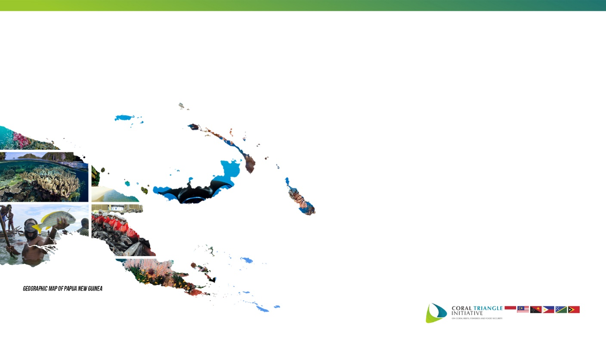
The 12th Senior Officials’ Meeting (SOM-12)
1-2 November 2016
Port Moresby – Papua New Guinea
Session 18:
the Draft Text of “Joint Ministerial Statement”
Widi A. Pratikto Ph.D.
CTI-CFF Regional Secretariat
2 November 2016

Slide 2

BACKGROUND
The Joint Ministerial Statement is a document regarding a number of acknowledgment, decision and recommendations produced by the Ministerial Meeting to provide pragmatic approaches for the CTI-CFF and its organs and bodies covering the key agreements and outcomes from previous meetings of Senior Officials.

Slide 3
PREPARATION OF DRAFT JOINT MINISTERIAL STATEMENT
On the occasion of the 6th Ministerial Meeting (MM-6), the CTI-CFF Regional Secretariat has initiated to prepare draft provisional Joint Ministerial Statement of the MM-6 in order to have ease reference for further discussion and consideration during the 12th Senior Officials’ Meeting (SOM-12).
It is expected that the SOM-12 will discuss and consider the draft provisional of Joint Ministerial Statement. The SOM-12 is expected to finalize the draft and to recommend the final draft for adoption by the 6th Ministerial Meeting (MM-6).

Slide 4
DRAFT JOINT MINISTERIAL STATEMENT
To be displayed by M-Word Version

Slide 5
RECOMMENDATION
Referring to the discussion and consideration among the SOM-12 on session on Discussion and Consideration on the Draft Text of “Joint Ministerial Statement”, the Senior Officials hereby:
To consider and to adopt the final text of draft Joint Ministerial Statement of MM-6.
To recommend to CTI Council of Ministers to adopt draft Joint Ministerial Statement.

Slide 6


