Slide 1
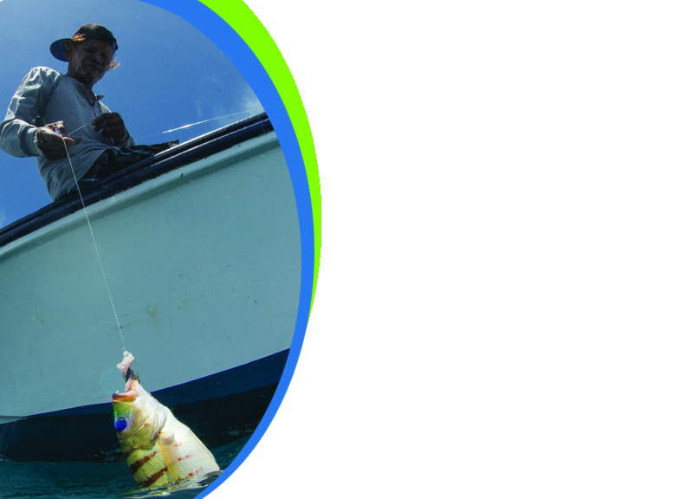
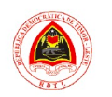






Workshop on Catch Documentation and Traceability (CDT) System Design and Development based on Ecosystem Approach to Management of Fisheries (EAFM)
25-26 June 2019 / Dili, Timor Leste
Progress and Planning of
Electronic Fishing Log Book
in Indonesia
Presented by :
Ilham
Head of Sectiom Fisheries Resources Analysis
Directorate of Fish Resources Management
Supported by:

Slide 2


Outline
Fishing Logbook in Indonesia
Fishing Logbook Analysis
Electronic Logbook in Indonesia

Slide 3
Fishing Logbook in Indonesia
1 |

Slide 4
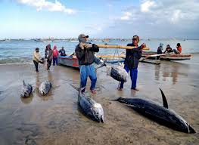
FISHING LOGBOOK REGULATIONS
Law No 45/2009 on Fisheries;
Marine and Fisheries Ministerial Degree PER.30/MEN/2012 jo PER.26/MEN/2013 about capture fisheries.
Marine and Fisheries Ministerial Degree No.12 2012 about EEZ capture fisheries;
CMM RFMO IOTC, Resolition IOTC 15/01, 15/02, 15/08 and Ecological Related Species (ERS). ;
Marine and Fisheries Ministerial Degree No 48 2014 about fishing logbook.

Slide 5
FISHING LOGBOOK
  Daily report is written by captain about fishing activities .
  Logbook is landing declaration by captain, or statement about fishing activities conducted and catch landed. .
By gear type
Fishing Ground by area
Fish Target
by catch
Discard
Ecological Related Species (ERS)
Data Hook Rate and CPUE

Slide 6
LOGBOOK MECHANISM
The completed log book
submitted to the Master Harbour / Log Book officer at the Port
as time goes by
until now, the completed log book has been submitted to the master harbour / log book officer to be done
Manual System
Captain puts data on logbook onboard.
Log book sheet sent to
DGCF -MMAF
Enter Log Book data at
Fishing Port
Enter Log book sheet
by Officer in DGCF
Elektronic Log Book

Slide 7
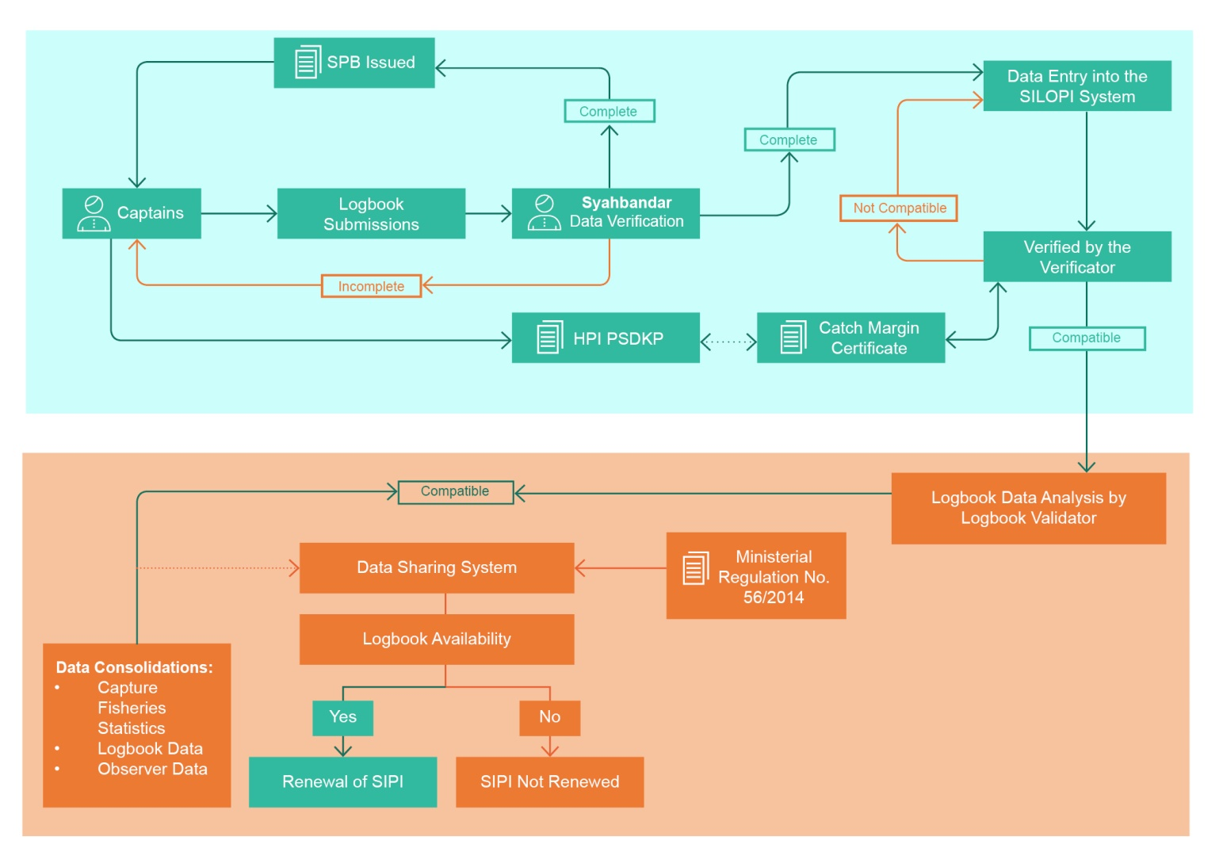
LOGBOOK FLOW CHART
START →

Slide 8
Fishing Logbook Analysis
2 |

Slide 9
Number of Fishing Vessel to submmit Log Book (BY SILOPI 2012-2018)

Slide 10
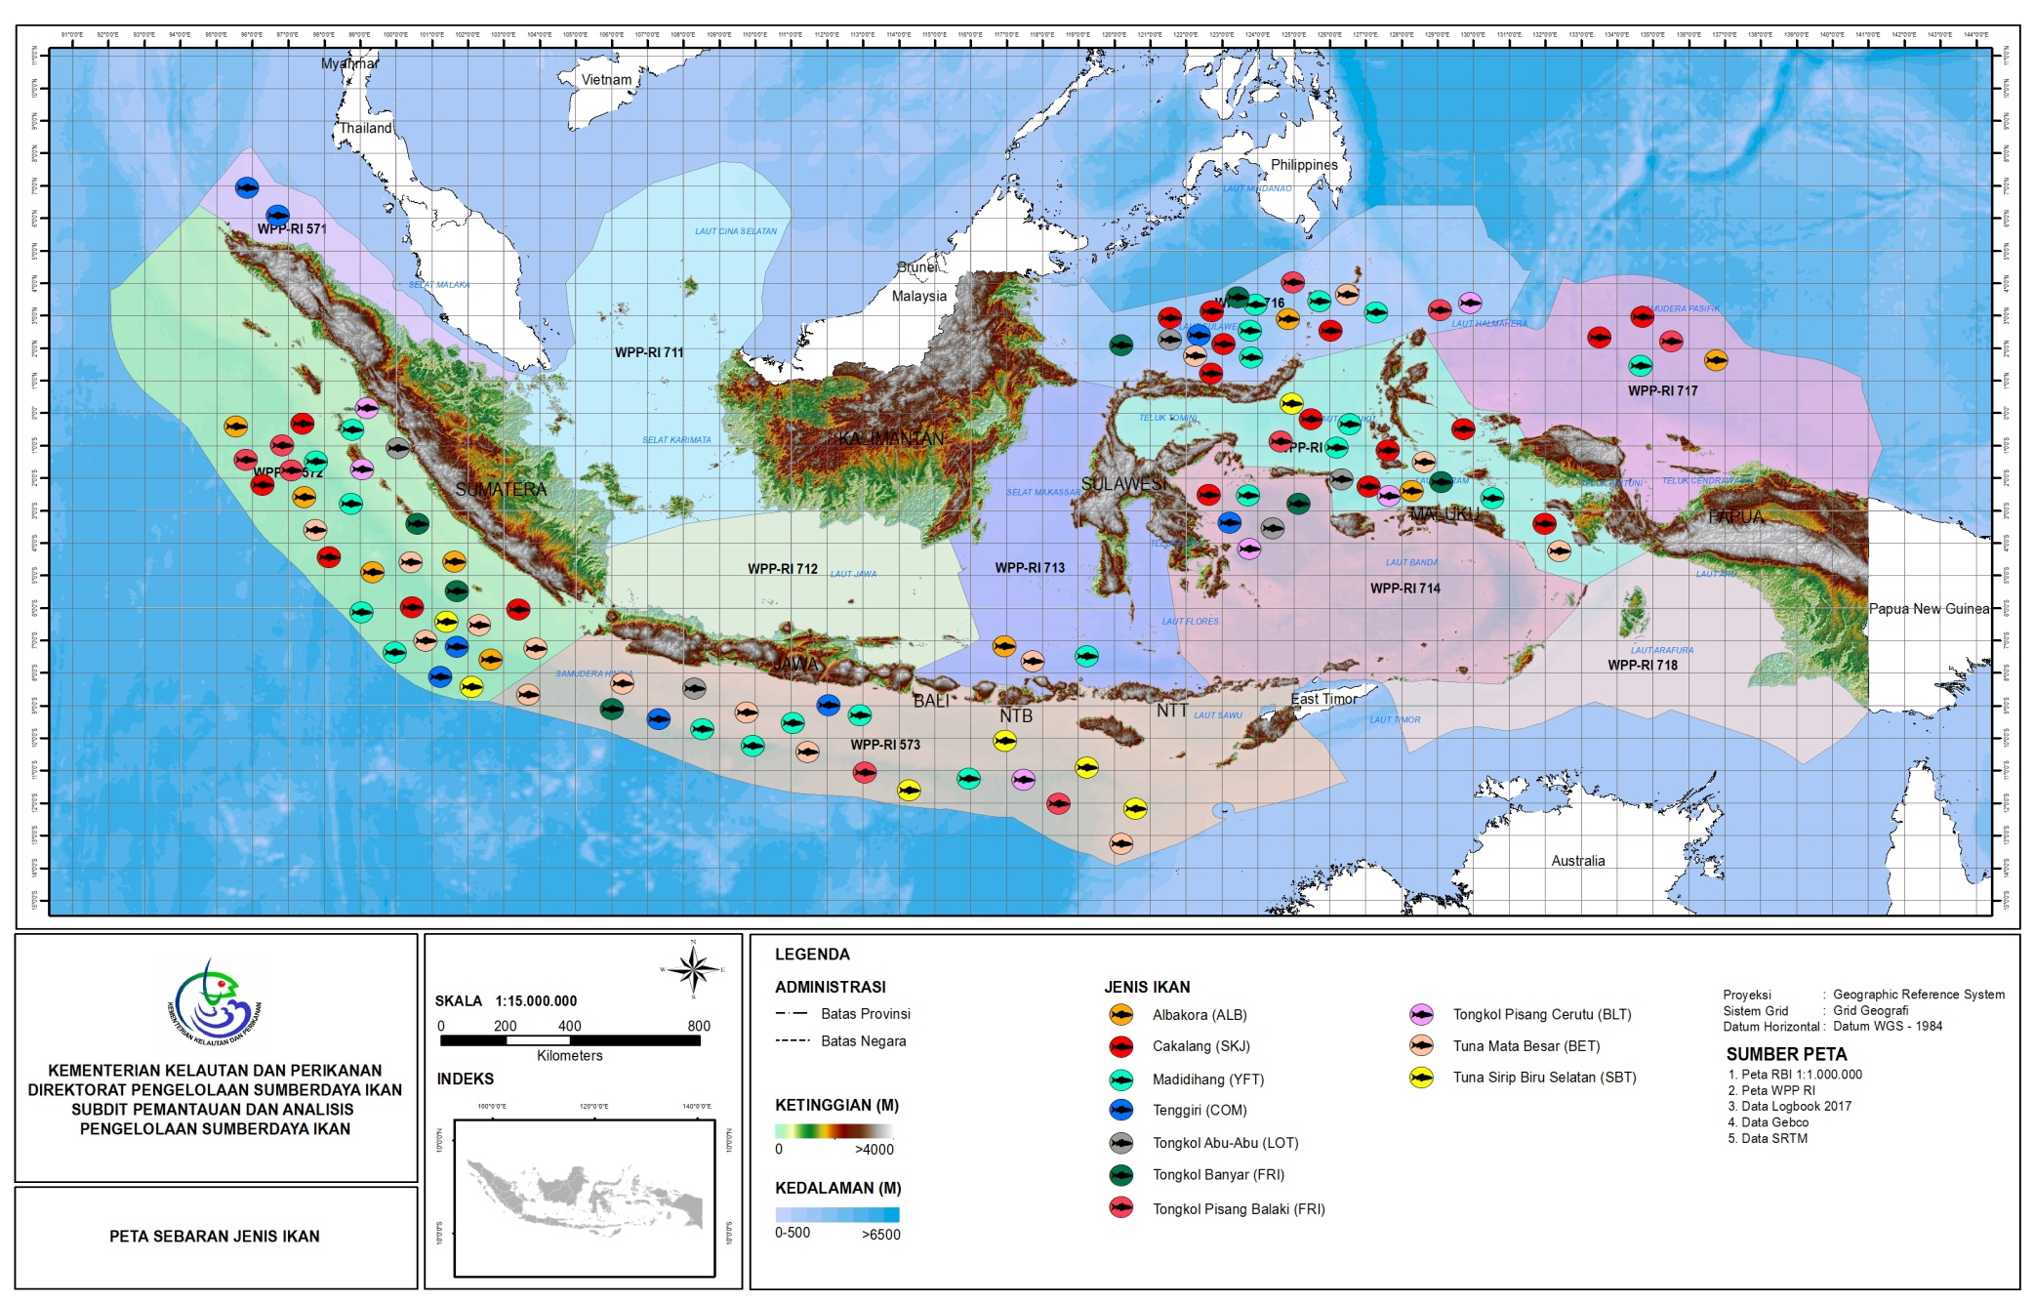
Distribution of Tuna by Log Book Information 2017

Slide 11

FISHING LOGBOOK IMPROVEMENT PLANS
Application –based validation system using Database Sharing System (DSS).
Implementing e-logbook;
Develop Fishing Logbook for small-scale fishers .
Pilot trial integrated VMS and SILOPI e-logbook .
VALIDATION AND MANAGEMENT
Logbook data = Fish landing data = DATA LKU and LKP.
SILOPI improvement
Support for logbook implementation DGCF Decree No. 1/PER-DJPT/2016 (Kapal Penyangga).
Compliance improvement to RFMO .
IMPLEMENTATION
Logbook implementation review KP 48/2014 :
Logbook has to be submitted when landing.
Stronger sanction incentive for incompliance .
Administrative notification .
REGULATION

Slide 12
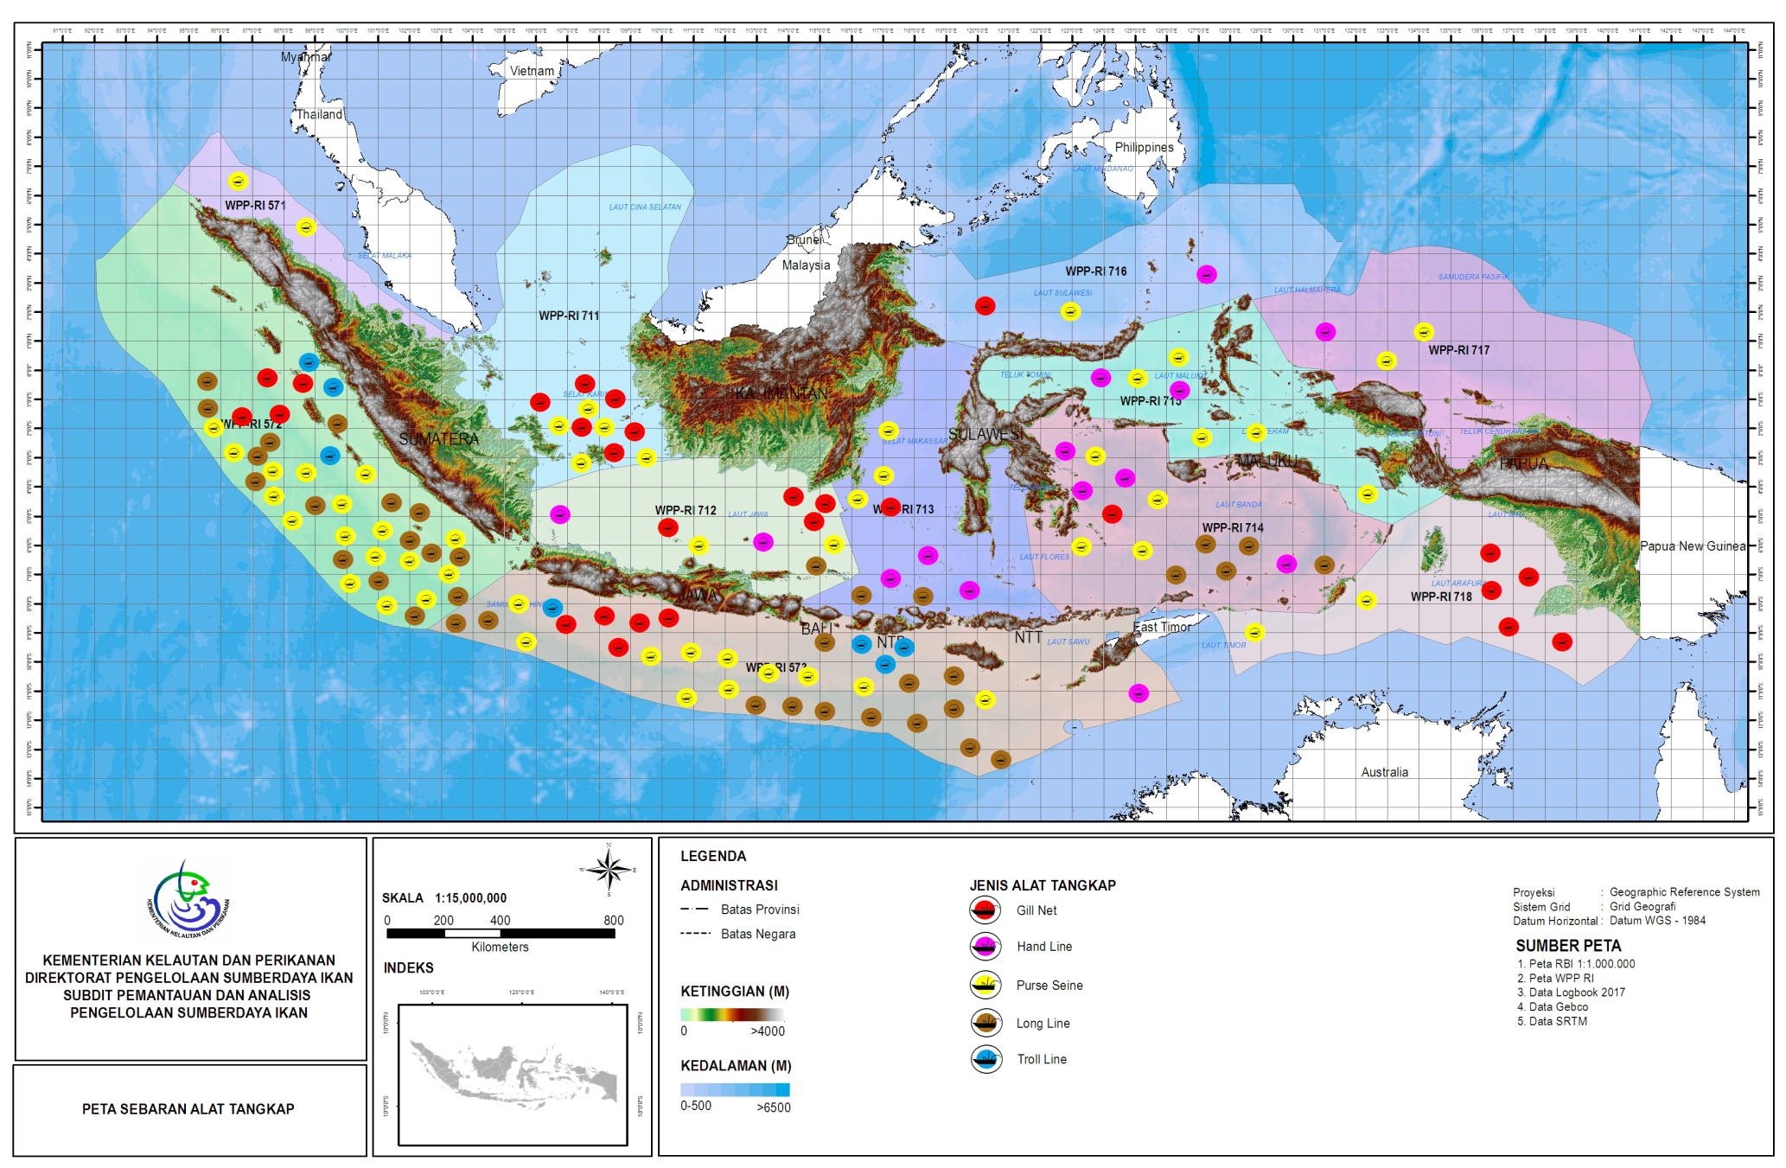
Distribution 0f Fishing Gear to Catch Tunas by Log Book Information 2017

Slide 13

3 |
Electronic Logbook in Indonesia

Slide 14
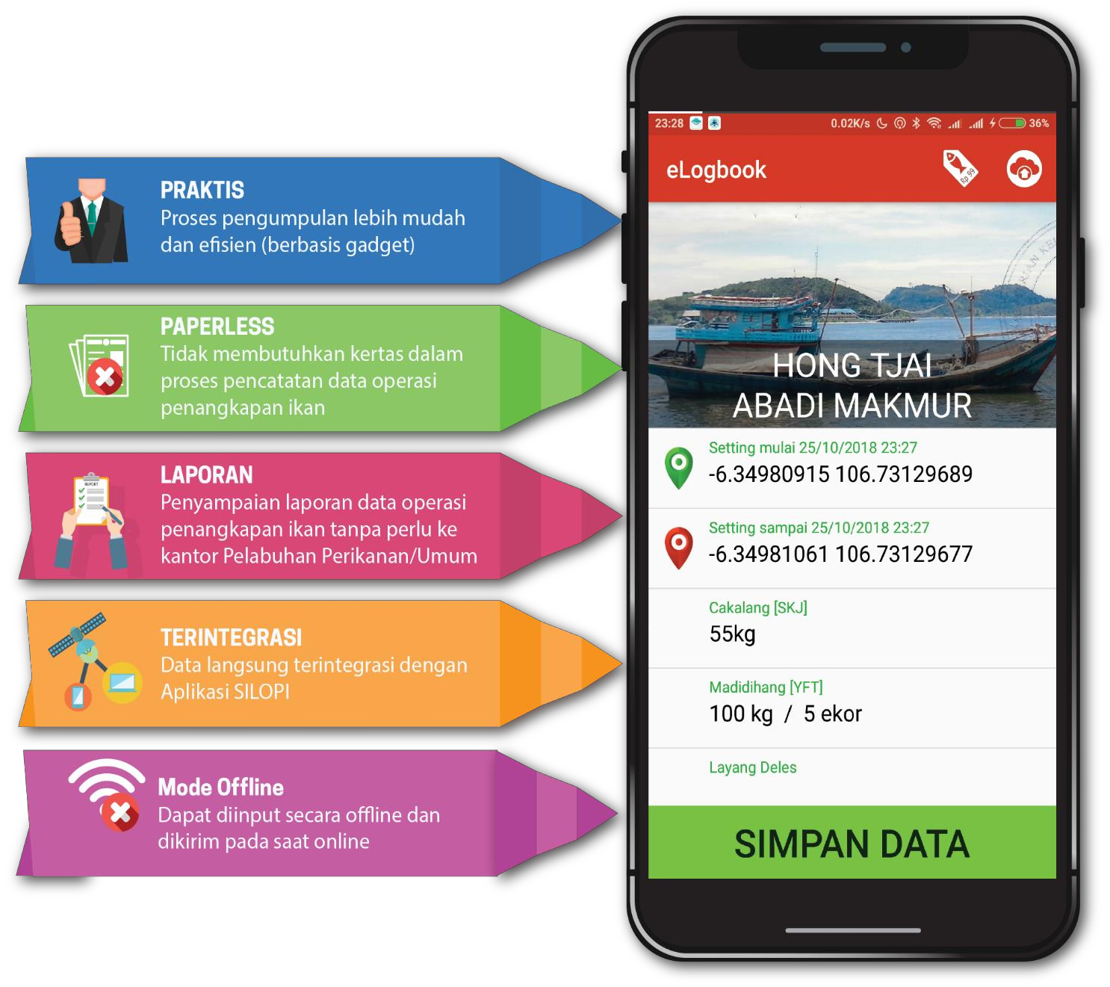
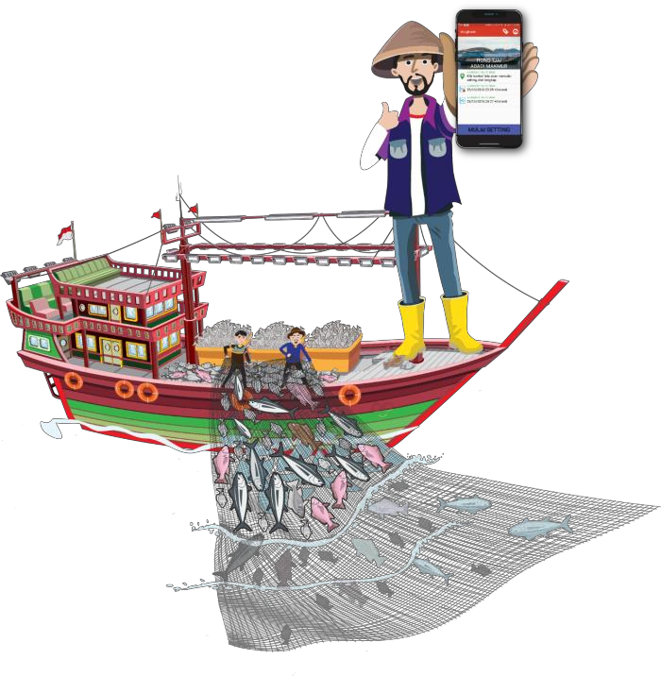
why e-LOG BOOK ???

Slide 15
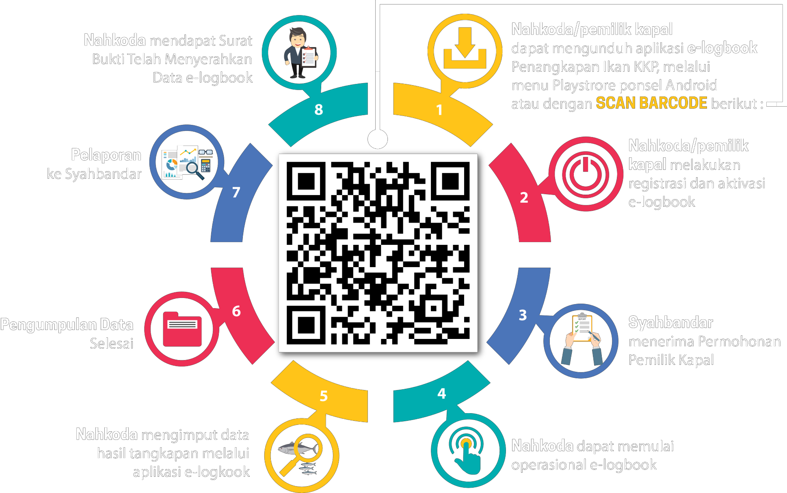
E-Log Book implementation

Slide 16









E-Log Book MECHANISM
e-Log Book Activation
Master Harbour / log book officer accepts the ship owner's request
Download
e-Log Book Apps in your android
START →
Starting
e-Log Book
Catch data settings
Receipt of
e-Log Book
Tell the master harbour / log book officer
Data collection complete
The e-Log Book application can be downloaded via Playstore (Android) or through the website www.e-logbookdjpt.kkp.go.id. The application must be activated immediately so that it can be used.

Slide 17
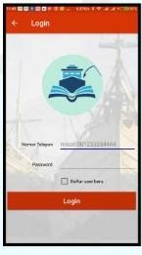

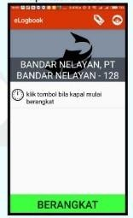
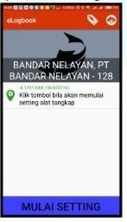
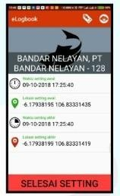
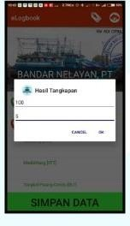
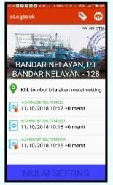
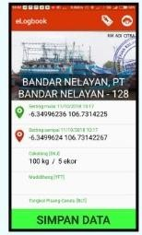
E - Log Book Aplication (by Android) System)
1
2
3
4
The captain activates
e-Log Book
Device synchronization
the captain is ready to leave after activation
Start setting
5
6
Start the next setting
7
Input of catch
8
"Finish Setting" after the first setting process is complete
data collection is complete and ready to be sent

Slide 18
Number of Fishing Vessel Aktivation E – Log Book (by Type of Fishing Port)
Vessels that have entered as of 27 March 2019 = 4285 Vessels
Oceanic Fishing Port has conducted ACTIVATION OF VESSELS with a total = 1563 vessels, with the highest composition found in Nizam Zachman Fishing Port with 706 vessels.
The Archipelagic Fishing Port has carried out ACTIVATION of VESSELS = 1394 vessels, with the highest composition found in Muara Angke Fishing Port = 451 vessels.
Data Source: Team of e-log book Activation 10 January 2018

Slide 19
Number of Fishing Vessel Aktivation E – Log Book (by Type of Fishing Port)
The Coastal Fishing Port has taken 363 vessels ACTIVATION, with the highest composition being in the Sungai Rengas and Klidang Lor Fishing Port with 119 vessels.
The Landing Site has carried out 964 vessels of Vessels ACTIVATION, with the highest composition found in Dobo with 454 vessels.
Data Source: Team of e-log book Activation 10 January 2018

Slide 20
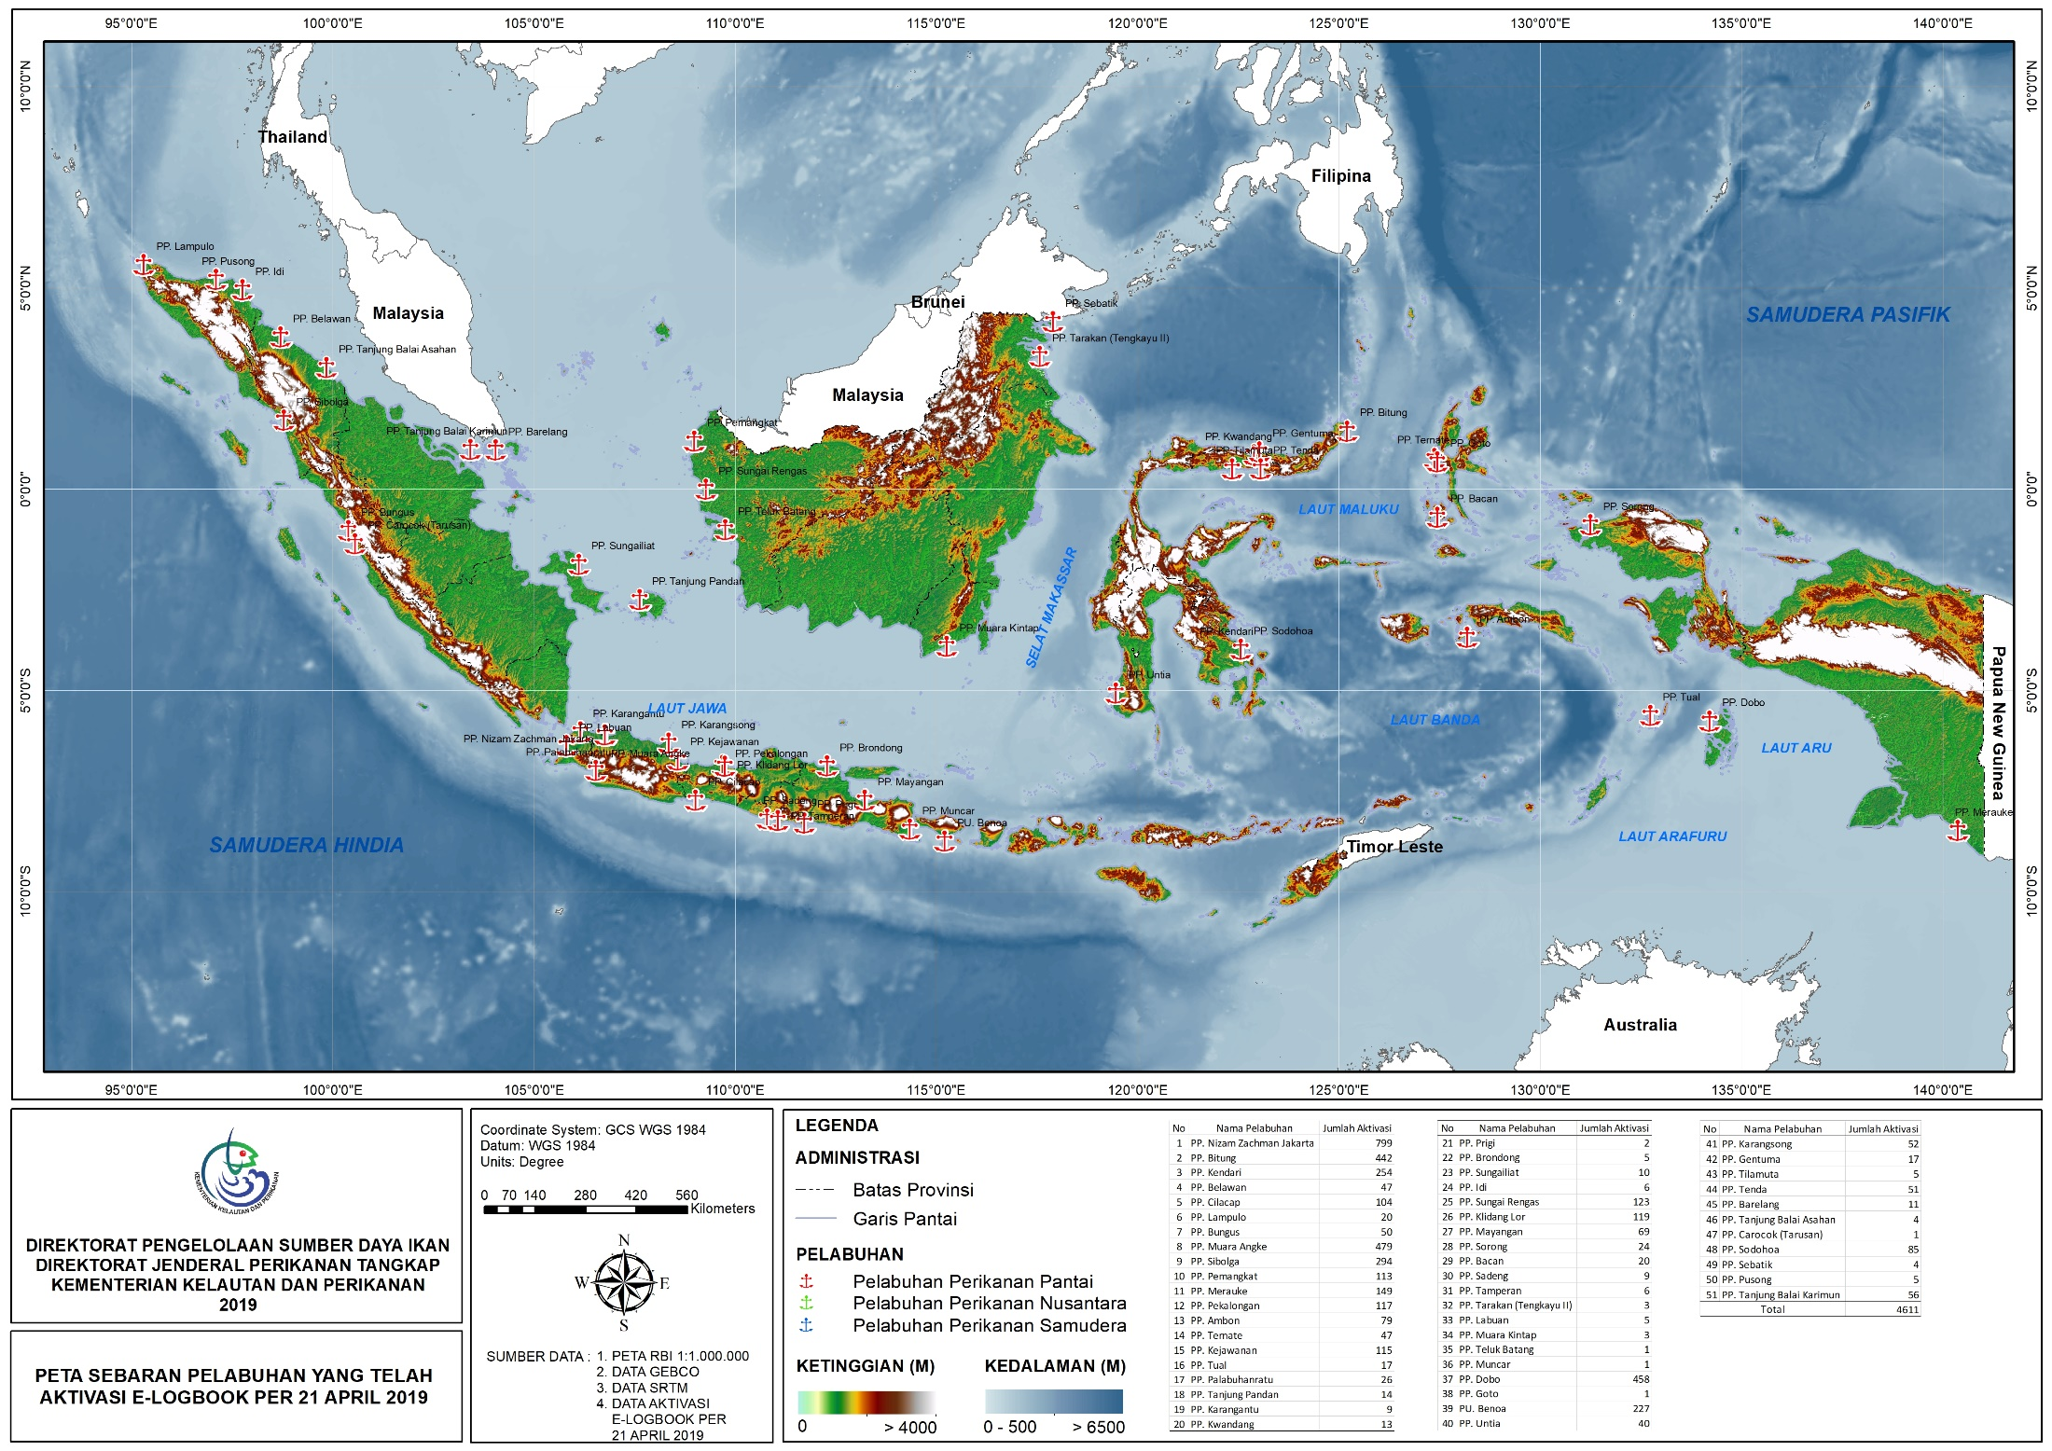
Distribution and Number of Fishing Vessel Aktivation E – Log Book

Slide 21
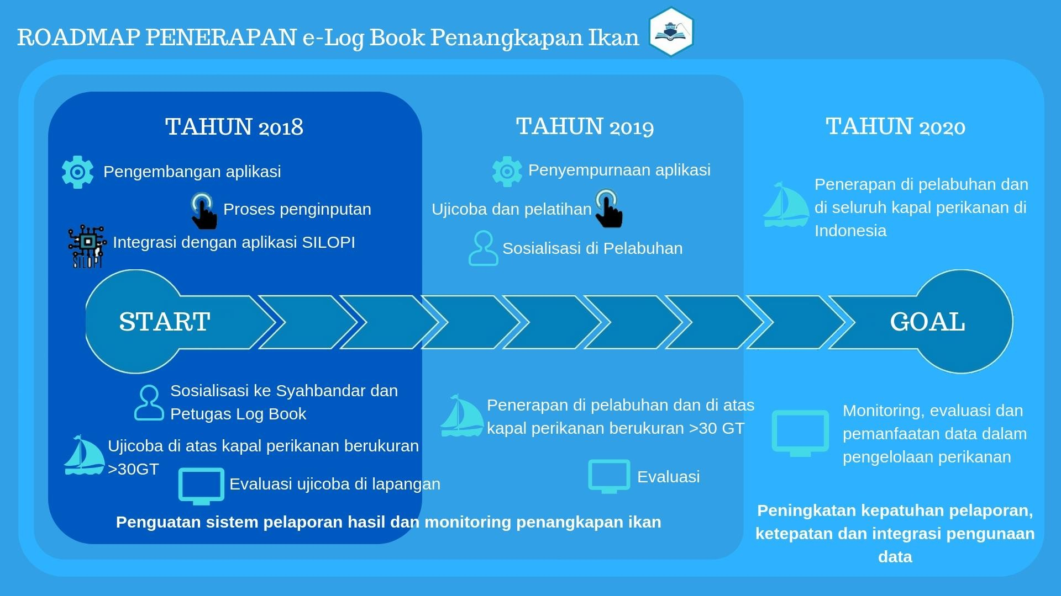
Roadmap E – Log Book implementations
Capacity Building for Officer/Fishers
Free WIFI at Fishing Port
Development Aplication for Analysis Data

Slide 22
Progress Activity For E-Logbook
Capacity building for Log Book officers at Fishing Port;
Achievement of the target e-logbook activation of 10,000 units of fishing vessels;
Placement of 80 Observer at 32 Fishing Port in Indonesia with the aim of verifying Log Book;
Increasing compliance of business actors for summit Log Book or E-Log Book through licensing sanctions mechanism;
Use of applications Log Book analysis system that is integrated with PIPP, SIPEPI, SILOPI, VMS and STELLINA.
Increased cooperation Log Book data analysis with experts from BRSDMKP and Universities.

Slide 23


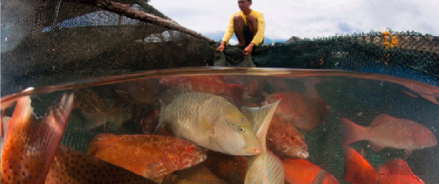
Terima Kasih - Maraming Salamat Tank Iu- Obrigado Tagio Tumas

