Slide 1
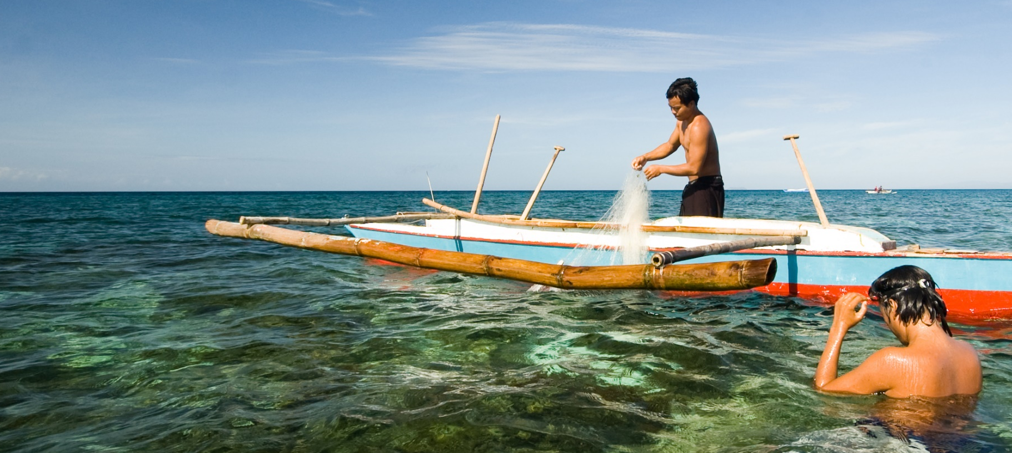




SOM14
14th Senior Officials’ Meeting
11-12 December 2018
Manila, Philippines
SESSION 10: COUNTRY REPORT
MALAYSIA
DIVISION OF STRATEGIC TECHNOLOGY & APPLICATION S&T
MINISTRY OF ENERGY, SCIENCE, TECHNOLOGY, ENVIRONMENT & CLIMATE CHANGE (MESTECC)

Slide 2

Status of NPOA (as of Nov 2018)

Slide 3
RPOA Progress in relation to NPOA

Slide 4




Technical Working Group Members / Focal Points
TWG | FOCAL POINT
Seascapes | Department of Fisheries, Sabah, Ministry of Agriculture & Food Industry Sabah (MAFI)
EAFM | Department of Fisheries, Sabah, Ministry of Agriculture & Food Industry Sabah (MAFI)
MPAs | Sabah Parks, Ministry of Tourism, Culture & Environment Sabah
CCA | Strategic Technology and S&T Application Division, Ministry of Energy, Science, Technology, Environment and Climate Change (MESTECC)
Threatened Species | Department of Fisheries, Ministry of Agriculture & Agro-based Industry Malaysia (MoA)

Slide 5
I. Progress/Achievements Towards NPOA
GOAL 1: PRIORITY SEASCAPES DESIGNATED & EFFECTIVELY MANAGED
ACTIVITIES | DATE & VENUE | NPOA | RPOA
Multilateral Meeting on Nomination of Lesser Sunda & Bismarck Solomon Seas Ecoregion as Priority Seascapes | April and October, Jakarta, Indonesia | Target 2 Action 2 and 3 | Target 2 Action 2 and 3
Seascape capacity-building and learning mechanisms: Sulu-Sulawesi Regional Convergence Meeting | July, Philippines | Target 2 Action 2 and 10 | Target 2 Action 2, 3 and 4
Finalize SWG Rules of Procedures and meeting protocols | October, Indonesia | Target 2 Action 1,4 and 5 | Target 2 Action 2 and 3
Fifth (5th) CTI-CFF Seascapes Working Group Meeting | October, Indonesia | Target 2 Action 1, 4 and 5 | Target 2 Action 2,3 and 4

Slide 6
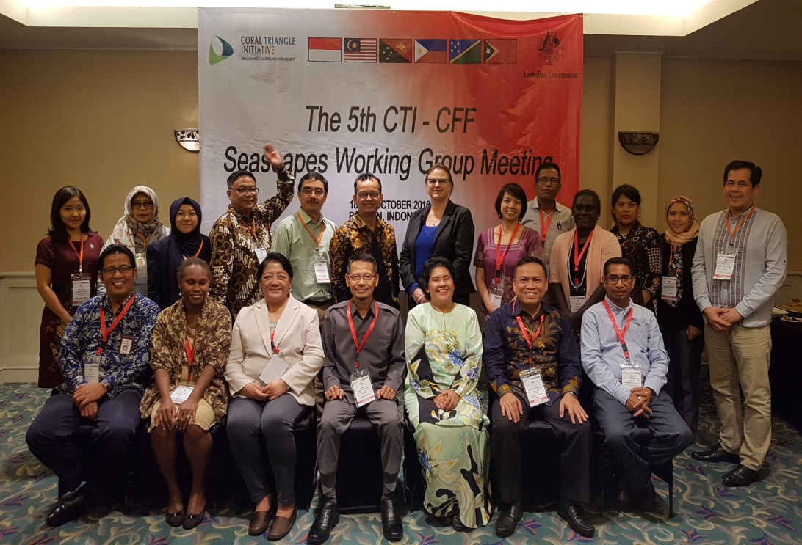
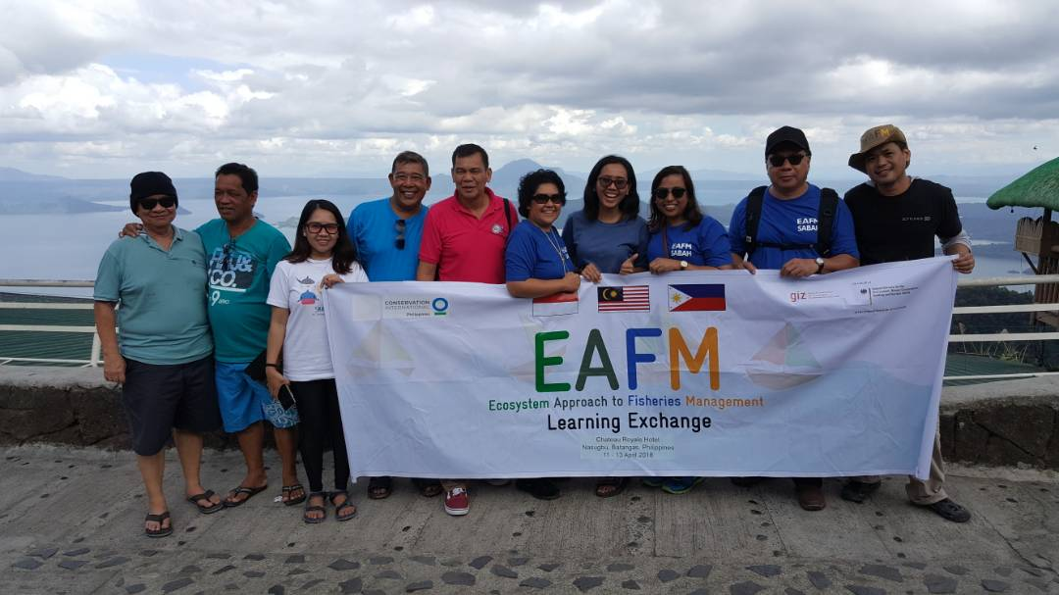
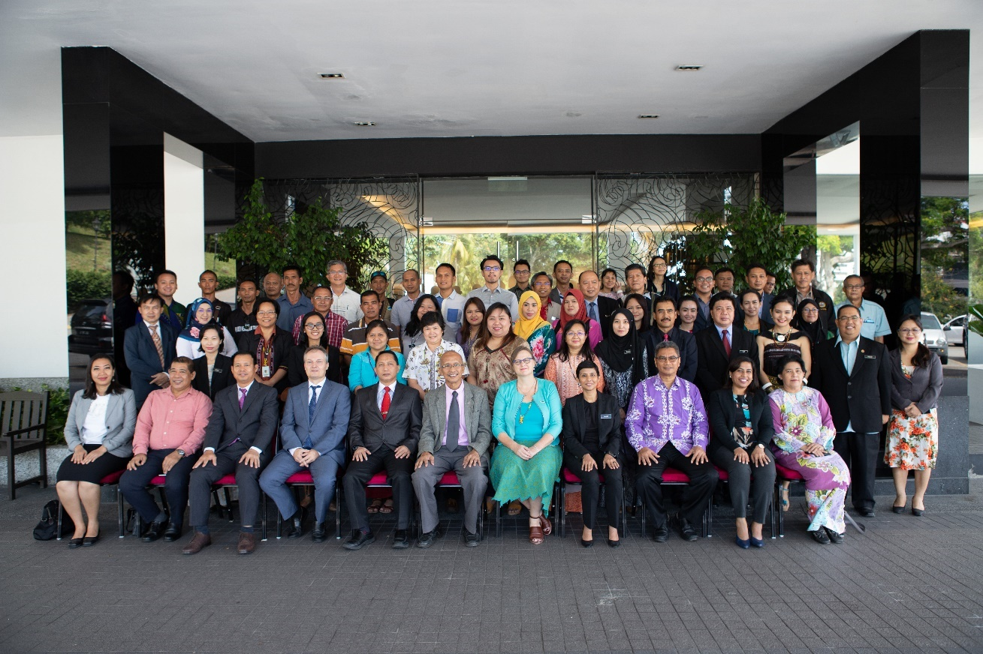
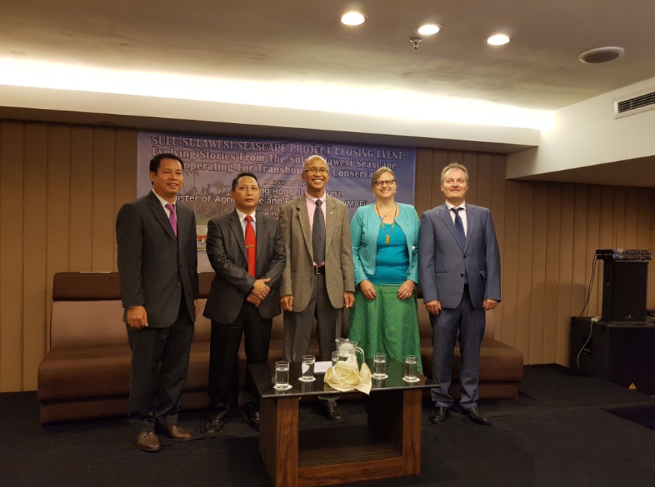
Sulu-Sulawesi Seascape Project

Slide 7
I. Progress/Achievements Towards NPOA
GOAL 2: ECOSYSTEM APPROACH TO MANAGEMENT OF FISHERIES & OTHER MARINE RESOURCES FULLY APPLIED (EAFM)
ACTIVITIES | DATE AND VENUE | NPOA | RPOA
Essential EAFM Training for Stakeholders | March & July, Sabah | Target 2 Action 10 and 11 | Target 2 Action 3
Essential EAFM Training | June and Sept, Sabah | Target 2 Action 10 and 11 | Target 2 Action 3
EAFM for Secondary School | Oct, Sabah | Target 2 Action 10 and 11 | Target 2 Action 3
EAFM Pitas Consultation for Anchovies | March, Sabah | Target 2 Action 1, 10 and 11 | Target 2 Action 2 and 3
EAFM Approach to Semporna Shark Conservation and Awareness | May, Sabah | Target 1 and 4 Action 1,10, 11 and 13 | Target 1 Action 1 and 2
EAFM Consultation for Anchovies for Fishermen from Pitas and Tawau | June, Sabah | Target 2 and 4 Action 1, 10 and 11 | Target 2 Action 2 and 3
The 3rd stakeholder consultation for EAFM Community Research Project for Small Pelagic | October, Sabah | Target 1 Action 1 and 14 | Target 2 Action 2 and 3

Slide 8
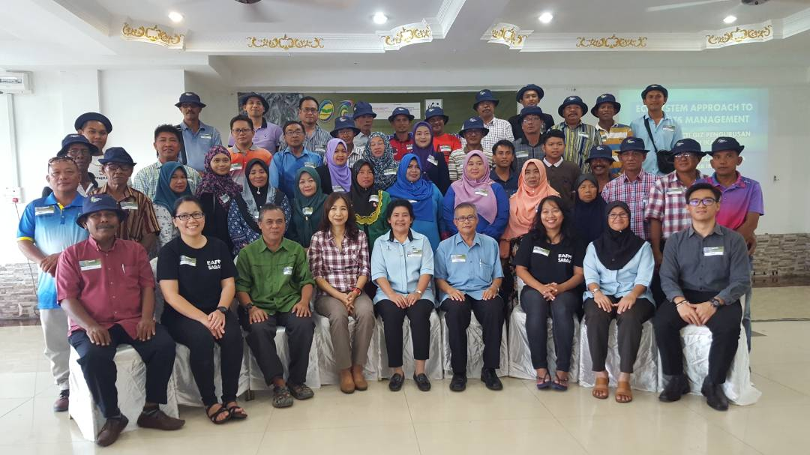
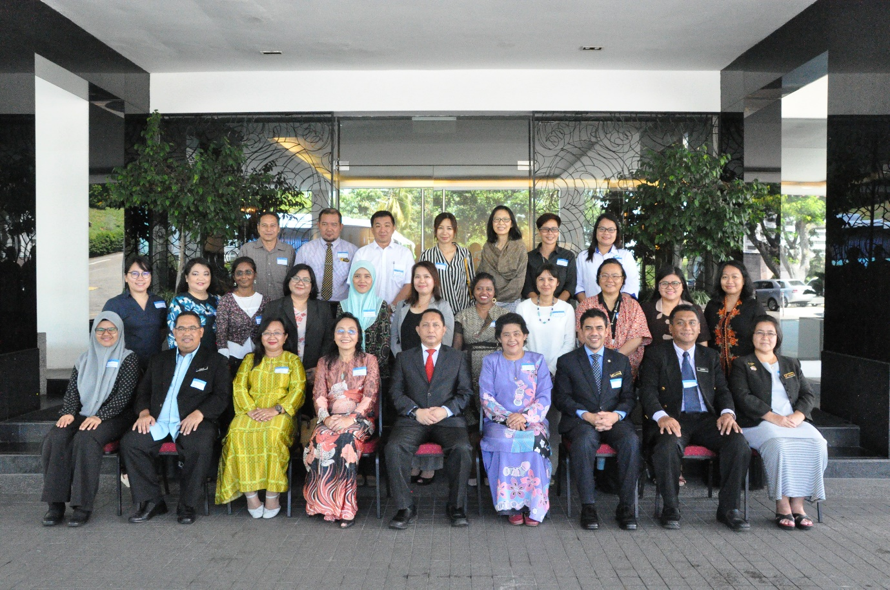
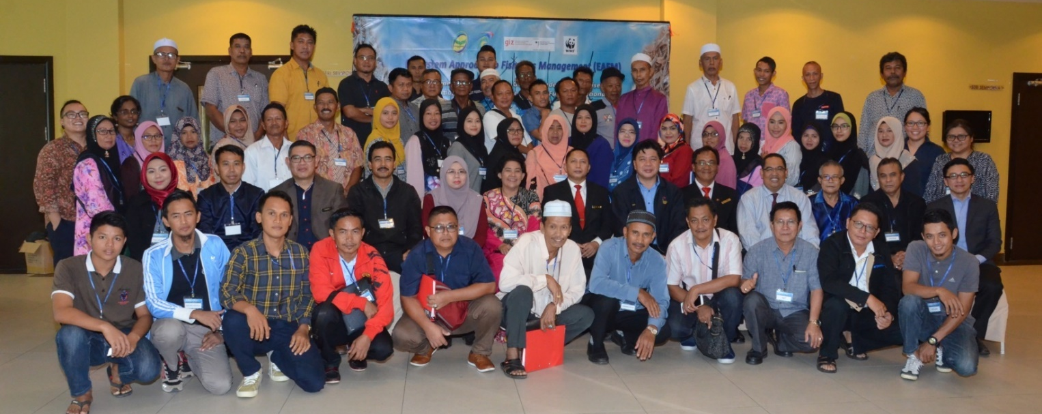
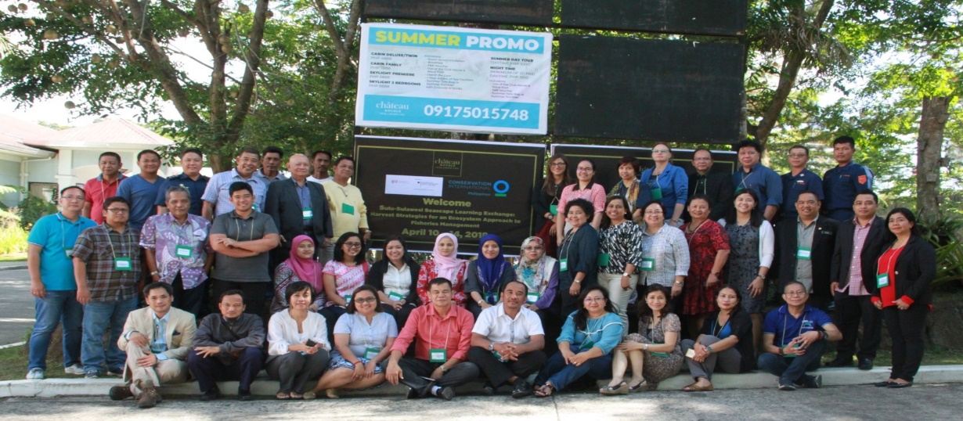

Slide 9
I. Progress/Achievements Towards NPOA
GOAL 3: MARINE PROTECTED AREAS (MPAs) ESTABLISHED AND EFFECTIVELY MANAGED
ACTIVITIES | DATE AND VENUE | NPOA | RPOA
13th Meeting for Turtle Islands Heritage Park JMC | July, Philippine | Target 1 Action 6, 7 and 11 | Target 1 Action 4, 5 and 6
MOU Signing with Universiti Malaya (UM) for joint benefits in research | February | Target 1 Action 7, 12, 13, 16, 17 and 19 | Target 1 Action 3, 5 and 6
Action Plan for Elimination of Fish Bombing in Tun Sakaran | Tun Sakaran Park, Semporna | Target 1 Action 4 | Target 1 Action 1, 3, and 4

Slide 10
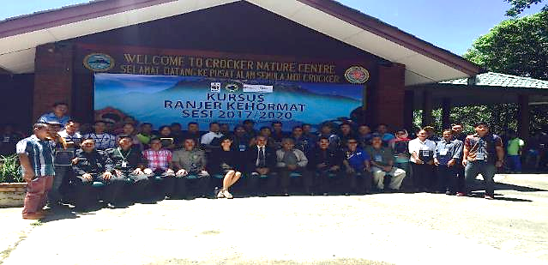
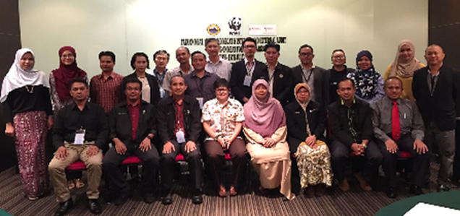
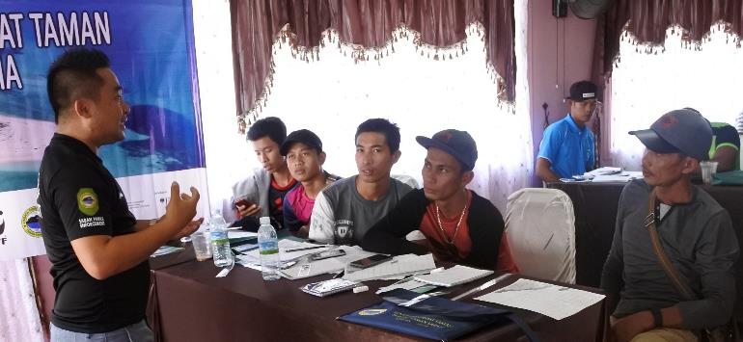
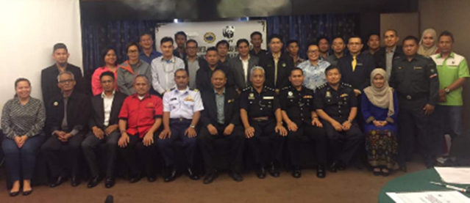
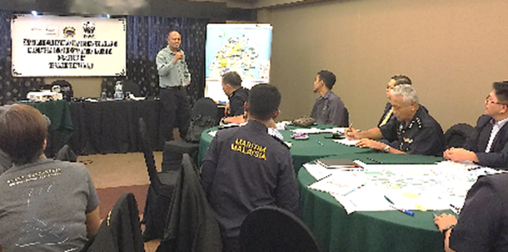

Slide 11
I. Progress/Achievements Towards NPOA
GOAL 4: CLIMATE CHANGE ADAPTATION MEASURES ACHIEVED
ACTIVITIES | DATE AND VENUE | NPOA | RPOA
5th CTI-CFF Climate Change Adaptation Working Group Regional Exchange and Grant-Writing Workshop | 10-13 April Kota Kinabalu, Sabah | Target 2 Action 1 | Target 2 Action 1
Students Exchange Programme Ludwig Maximilian University, Munich Germany and Borneo Marine Research Institute, University Malaysia Sabah | February, Sabah | Target 1 Action 15 and 16 | Target 1 Action 1, 3 and 5
International Conference on Marine Science and Aquaculture (ICOMSA) 2018 | March, Sabah | Target 1 Action 1, 2, 3 and 13 | Target 1 Action 3, 4 and 5
Grant Opportunities Workshop (EU Horizon 2020 and Other Opportunities) | March, Sabah | Target 1 Action 1, 2, 3 and 13 | Target 1 Action 3, 4 and 5
Youth Climate Change Training Camp #POWERSHIFTSABAH2018 | July, Sabah | Target 1 Action 15 and 16 | Target 1 Action 1,3 and 5
Coral Triangle Day 2018 in conjunction with the Marine Biodiversity Awareness Week (MBAW) 2018 | July, Sabah | Target 1 Action 15 and 16 | Target 1 Action 1,3 and 5
Marine BioD Edu-Station in conjunction with Marine Biodiversity Awareness Week (MBAW) | July, Sabah | Target 1 Action 15 and 16 | Target 1 Action 1,3 and 5

Slide 12
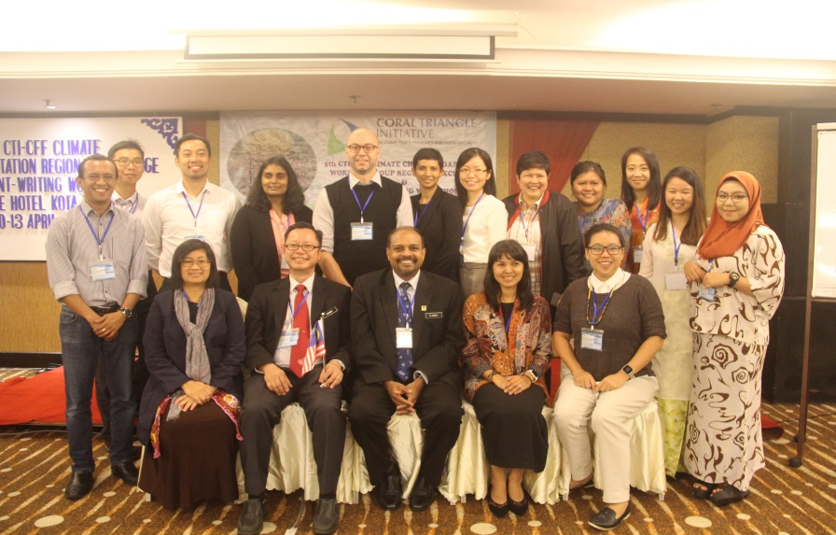
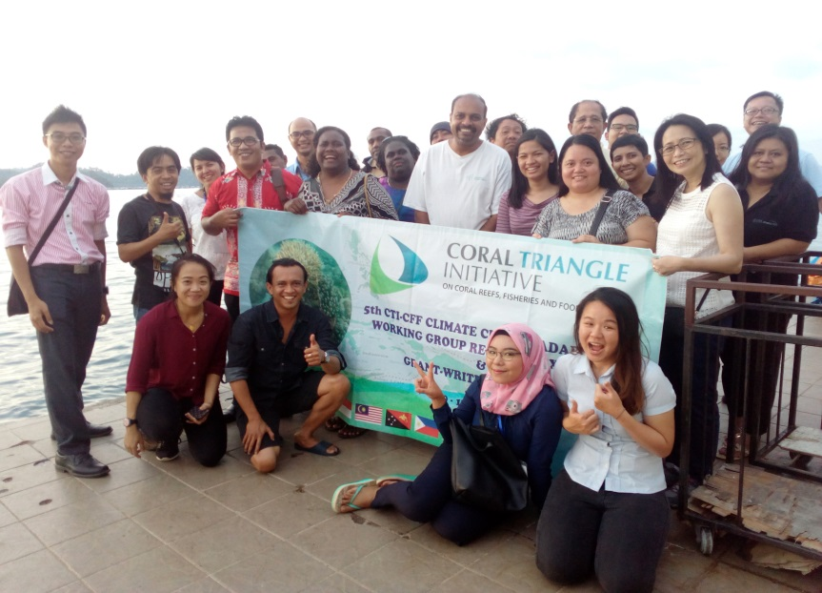
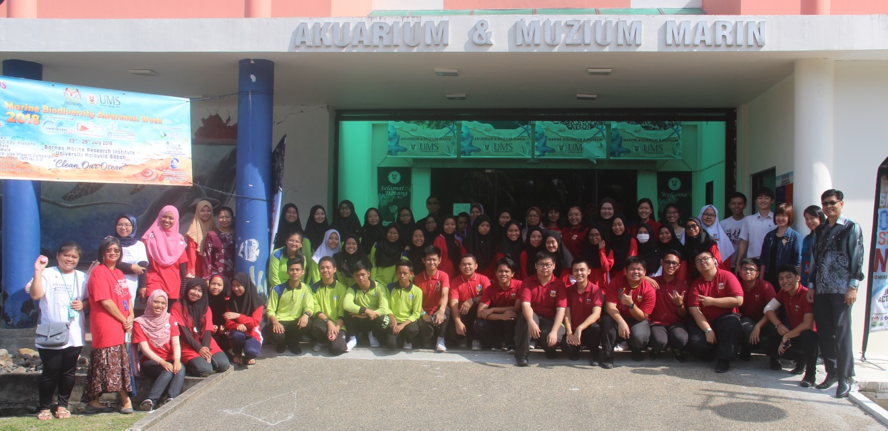
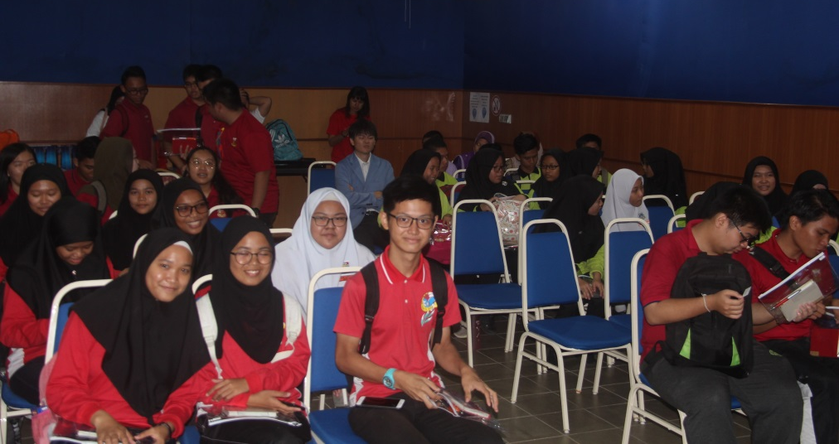

Slide 13
I. Progress/Achievements Towards NPOA
GOAL 5: THREATENED SPECIES STATUS IMPROVING
ACTIVITIES | DATE AND VENUE | NPOA | RPOA
CTI-GIZ Project, Semporna: Stakeholder Engagement of EAFM Project for Sharks Conservation | May, Sabah | Target 1 Action 2, 11,15, 16,17 and 19 | Target 1 Action 1, 2, 8 and 9
1st Technical Working Group on Threatened Species chaired by Deputy General Director (Development) | November, Putrajaya | Target 1 Action 10, 11 and 16 | Target 1 Action 6, 8 and 9

Slide 14
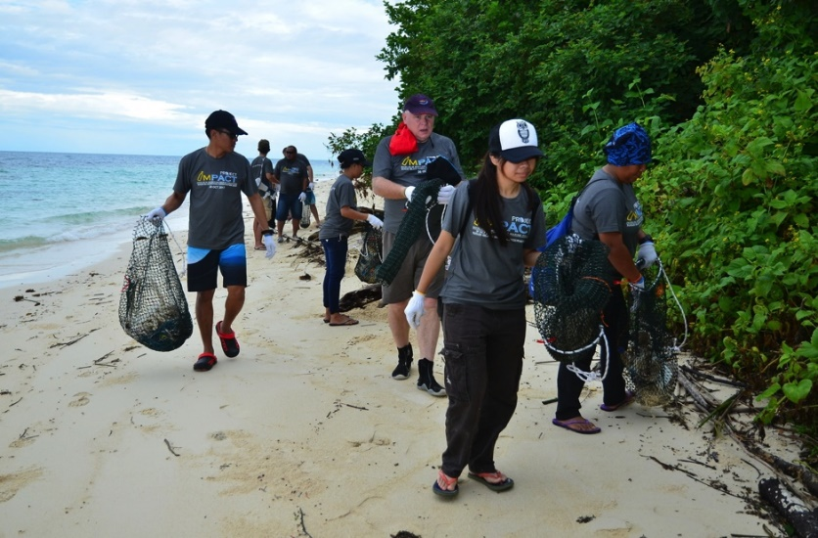
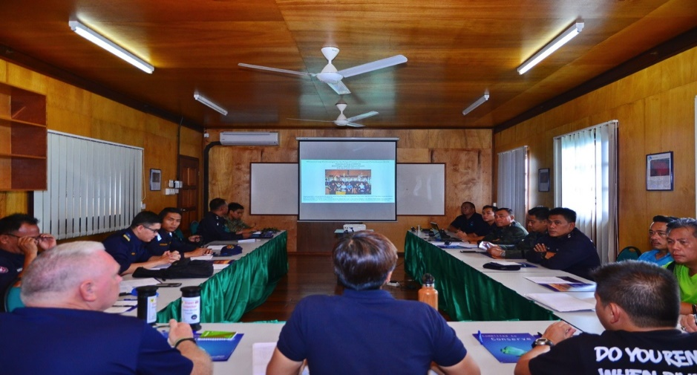
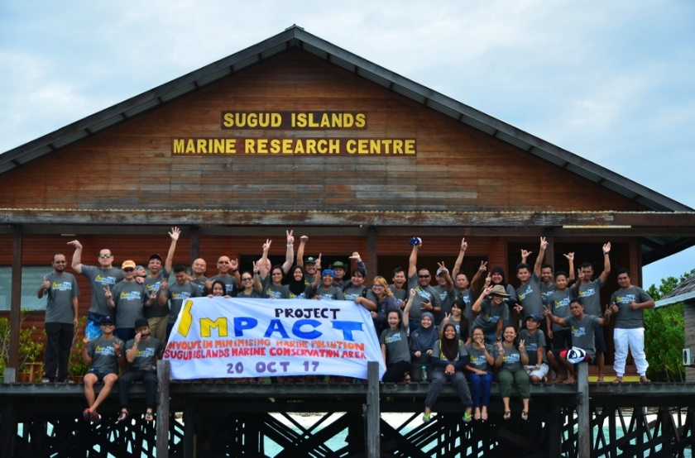
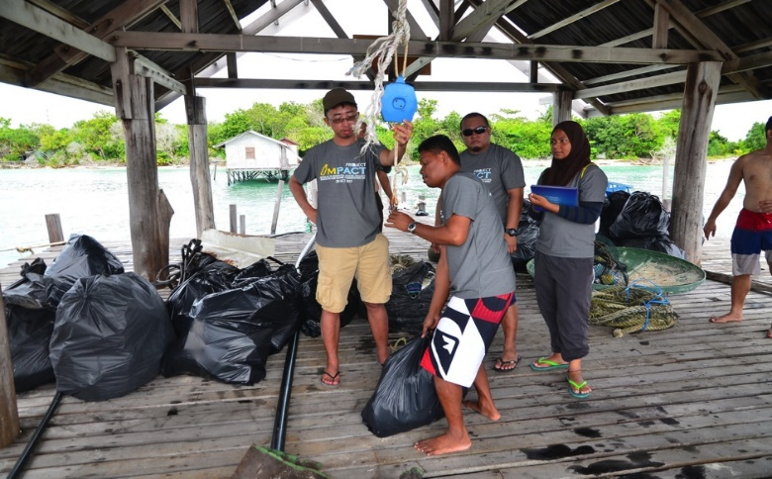

Slide 15
II. Constraints/Issues/Challenges
Affecting Implementation of Identified Activities
Limited resources
  Knowledge – gaps at different levels
  Manpower
  Financial
2. Stakeholders participation

Slide 16
III. National Roadmap 2019 – main actions
Develop concrete joint management action/plans based on connectivity and characteristics between the Sulu-Sulawesi countries;
Endorsement of the Sulu-Celebes (Sulawesi) Large Marine Ecosystem Regional Strategic Action Plan for Sustainable Fisheries Management for GEF International Waters (GEF IW) funding (facilitated by UNDP with assistance from CI).
Propose a regional GEF project on Plastic Pollution & Marine Debris with a circular economy approach
Expansion of all current MPAs & introduce 3 new MPAs; 2.041 million ha in total (14.3% Aichi goal)
Third round of CTMPAS nomination – recognition of effective managed
Workshop on adaptation to climate change within the Coral Triangle (CT) area: the role of Ecosystem-based Adaptation (EAB)
Blue Carbon Workshop
Climate Change Seminar – across goals and other national initiatives
Establishment “Network National Centers of Excellence (COE) on CCA”
Seminar on Goal 5 Threatened Species CTI Areas

Slide 17
III. National Roadmap 2019
NPOA Review
Malaysia has yet to review NPOA. (last update 2016)
The review will be conducted after conclusion of RPOA 2.0.
National workshop – RPOA/NPOA

Slide 18
IV. Way Forward
National
Review of NPOA in line with RPOA 2.
Regional
CTI- for common good of mankind and reiterate the CBDR
Looking forward to RPOA 2.0
  2019 – a year to reflect – RPOA 2.0
  focus, priority driven, implementable
  Resource mobilisation
  Branding of CTI
  Renewed political will

Slide 19
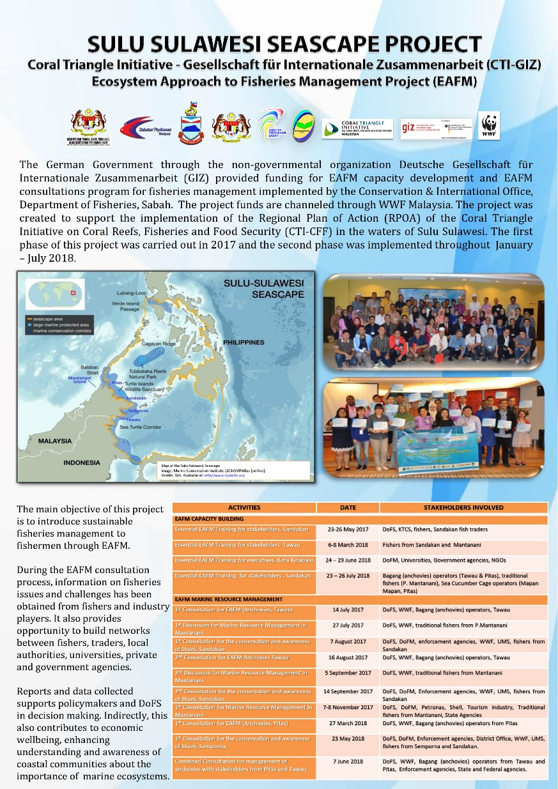
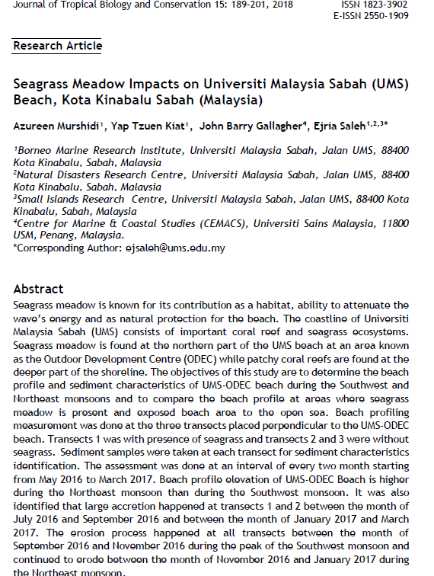
VI. Documents/Materials/Publications
EAFM FACT SHEET
CCA JOURNAL, AUGUST 2018

Slide 20
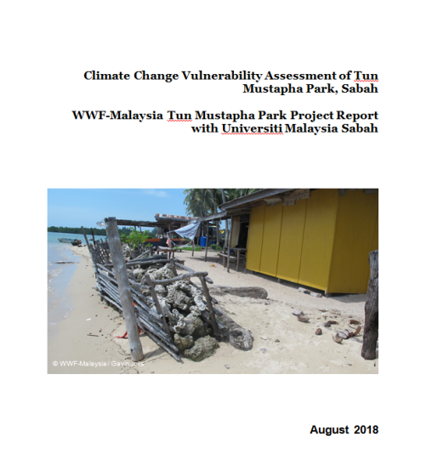
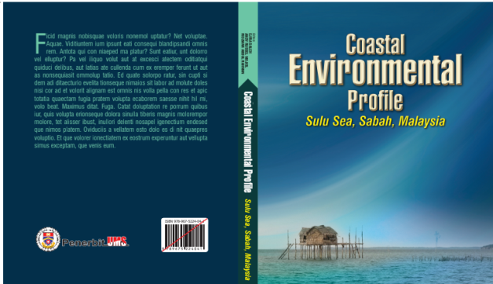
VI. Documents/Materials/Publications

Slide 21
VII. Other Remarks
5th Regional Business Forum
Malaysia withdraw from hosting the forum
Handover Chairmanship of CCA WG
Malaysia will takeover chairmanship from Indonesia. Solomon Islands will act as Vice-Chairman
Handover Chairmanship of Seascape WG
Malaysia is ending the term of Chairmanship of CCAWG and will handover to Philippine

Slide 22


Terima Kasih - Maraming Salamat Tank Iu- Obrigado Tagio Tumas
Photo credits: IYORBank_Rebecca Weeks and Yen-Yi Lee

