Slide 1

The 12th Senior Officials’ Meeting (SOM-12)
1-2 November 2016
Port Moresby – Papua New Guinea
Session 16:
Proposal on Meeting Arrangements
Widi A. Pratikto Ph.D.
CTI-CFF Regional Secretariat
2 November 2016

Slide 2

OUTLINE
Background
Objectives
Proposal on Meeting Arrangements
  Hospitality Arrangement by the Host Country
  Layout of Meeting Room
  Immigration
  Informative Notes
Conclusion
Recommendations

Slide 3
BACKGROUND
Throughout international fora, and across cultures, special importance has been placed on dealing with people in particular positions of influence and importance at the official occasions or meetings of international and regional organizations.
It is the art of ensuring that official occasions (e.g. meetings) are planned and conducted in cordially manners by providing the delegates from member countries with facilities for their better arrangements

Slide 4
OBJECTIVES
To give guidelines for the Host Country/Organizing Committee in conducting official occasion as well as for Participants for their ease reference
to standardize the way of events’ administrative arrangements

Slide 5
PROPOSAL OF MEETING ARRANGEMENTS:
1) HOSPITALITY ARRANGEMENT BY THE HOST COUNTRY
It is a common practice in the international/regional organizations and in foreign affairs that the Host Country to provide hospitality for the delegates/officials attending official occasions, in particular for the level of Senior Officials and Ministers level
It is with a view of having hospitality extended by the Host Country in order to build mutual relation with the participants/delegates from member countries during their stay for attending the official meetings.
In this regard, the proposal of hospitality would be only related with the hotel accommodation to be extended by the Host Country.

Slide 6
PROPOSAL OF MEETING ARRANGEMENTS:
1) HOSPITALITY ARRANGEMENT BY THE HOST COUNTRY (CONT’D)
The proposal enlightens that the Host Country will cover who will be accommodated and hotel accommodation along with its services from Member Countries.
Who:
Ministerial Meeting : Minister + 2 officials (e.g. Minister + Advisor/Expert Staff to Minister + 1 from SOM)
Senior Officials’ Meeting : Senior Officials + 1 officials (e.g. Senior Officials + Director/Deputy Director related to the field)
Regional Secretariat : Executive Director
In case the meetings, i.e. MM and SOM are held back-to-back, then the three (3) officials to be accommodated at the MM are the same officials to be accommodated at the SOM). However, it may be noted that the hospitality extended by the Host Country may vary depends on their budget allocation.
Hotel accommodation:
a) Number of Nights: it will depends on the days’ of meeting. Cost of accommodation to be paid by host a day before the meeting to the final day of meeting. Any day before/after those sated dates/days will be borne by the participants.
b) Services:
  Hospitality for Heads of state and government and for Ministers will cover all meals, laundry service, and local telephone calls.
  Hospitality will not include beverages from the bar, extra meals, alcoholic drinks, international telephone calls and tobacco. All extra charges not covered in the hospitality will be settled at the time of check out.

Slide 7
PROPOSAL OF MEETING ARRANGEMENTS:
2) LAYOUT OF MEETING ROOM
As of common practice in the international and regional fora, the layout of meeting room is required to be arranged with U-Type seating format, as displayed at next slide)
For each Member Country (to be arranged in alphabetical order), there would be two front seats for member of Committee of Senior Officials, and four back seats for the rest member of delegation. The Head Table shall be presided by Chairman, and Executive Director on his left side.
Meeting Room should be equipped with as follows:
  Banner/Backdrop, standing flags and table flags
  Head table (i.e. Chair, Co-Chair and Executive Director) and country's name at their respective table
  clear sound system equipment along with sufficient amount of microphone (i.e. each of table shall be equipped with microphone)
  high resolution LCD Projector and White Screen
  Television at the front of head table for the Chair to look for the proceeding
  sufficient amount of stationaries (book notes, pencil, pens, staples, etc.)
  internet connection if possible
  Sound Engineering should be in stand by position at their own equipment

Slide 8
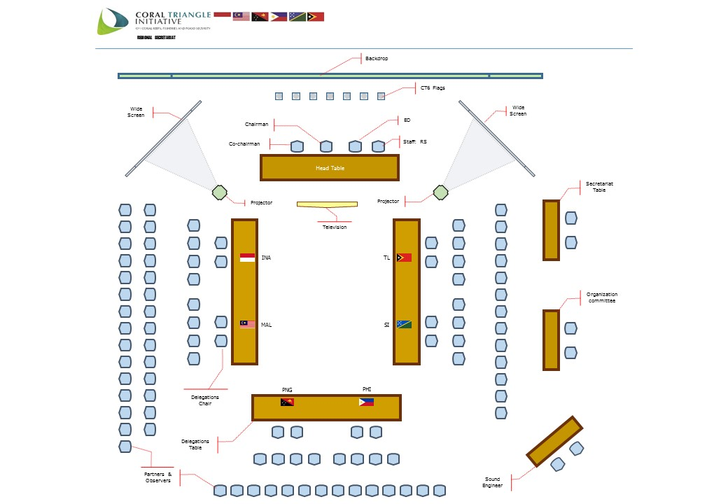
Proposal of Meeting Arrangements:
2) Layout of Meeting Room

Slide 9
PROPOSAL OF MEETING ARRANGEMENTS:
3) IMMIGRATION
It is well known that the visa requirement would one of most important procedures for the participants attending any official occasions. In this regard, it is proposed as of follows:
It is proposed that the Host Country, besides providing invitation letters, may also provide some sort of letter informing that the participants who will attend the meeting and requesting the respective Diplomatic Mission of host country located in the origin of participants’ location for the visa application.
It is proposed that the Host Country shall provide a “Facilitation and Reception Desk” at the airport. This desk will help and facilitate the participants during the immigration process

Slide 10
PROPOSAL OF MEETING ARRANGEMENTS:
4) INFORMATIVE NOTES
In order to have clear picture on how the way of arrangements for the meetings to be conducted, it is proposed that the Host country/Organizing Committee prepare a document entitled “Informative Notes” / “ Administrative Notes”
“Informative Notes” is a set of guideline and information regarding event to be conducted.
“Informative Notes” shall be provided during the dispatching of invitation letter.
“Informative Notes”, among others, consists of:
1. Introduction | 5. Registration and Accreditation | 9. Liaison Officer | 13. Internet Facility | 17. Electricity
2. Meeting Information (i.e. date and venue of meeting along with detailed address) | 6. Hospitality (i.e. Accommodation, Transportation, Meals) | 10. Dress Code (i.e. business attire or national dress with shoes) | 14. Business Centre | 18. Weather
3. Information Desk (i.e. providing Desk at the venue) | 7. Protocol and Immigration (i.e. visa information) | 11. Language | 15. Address of Embassy in the Host Country
4. Contact Person | 8. Security Arrangement | 12. Medical Facility | 16. Currency and Cards

Slide 11
CONCLUSION
In accordance with common practice of international and regional organizations in conducting officials meetings, standardization of official occasion (e.g. meetings) arrangement would bring benefits for the host country and participants in term of the level of attendance and the product of meetings (e.g. decisions, recommendations)
Better arrangements of official meetings would give clear picture for both Host Country and participants in preparing their respective preparation and procedures
It would be expected that with standardized meeting arrangements would give more ease in conducting and facilitating any official meetings in the future.

Slide 12
RECOMMENDATION
To note and appreciate the proposal of meeting arrangements, i.e. hospitality arrangement, layout of meeting room, immigration and document of informative note as part of having standardization of meeting arrangements in the CTI-CFF
To acknowledge and confirm the proposal to be taken into consideration by the Host Country of future official meetings for further arrangement and preparations

Slide 13


